Slide 1
Variables in python
Dr. Ahmad Altarawneh

Slide 2
What are variables
In any programming language, variables are container to store values.
Python has an easy syntax for declaring a variable.
Variable name = Variable value
A variable is created the moment you first assign a value to it.
Variables do not need to be declared with any type and can even change type after they have been set.
Python can detect the data type from the assigned value
x = 5 y = "John" print(x) print(y)

Slide 3
Variable rules
In Python there are some rules to follow when you want to define a variable
Variable names can contain only letters, numbers, and underscores.
They can start with a letter or an underscore, but not with a number. For instance, you can call a variable message_1 but not 1_message.
Spaces are not allowed in variable names, but underscores can be used to separate words in variable names.
For example, greeting_message works, but greeting message will cause an error.
Avoid using Python keywords and function names as variable names.
that is, do not use words that Python has reserved for a particular programmatic purpose, such as the word print.
Variable names should be short and descriptive.
For example, name is better than n, student_name is better than s_n, and name_length is better than length_of_persons_name.
Be careful when using the lowercase letter l and the uppercase letter O because they could be confused with the numbers 1 and 0.
Variables are case sensitive

Slide 4
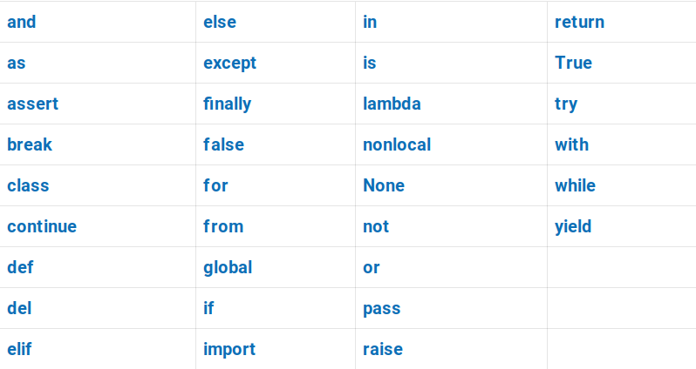
Python keywords

Slide 5
Multiple variables
In Python you can assign multiple values to multiple variables
Or one value to multiple variables
x, y, z = "School", "Bus", "TV" print(x) print(y) print(z)
School
Bus
TV
x = y = z = "Python is nice" print(x) print(y) print(z)
Python is nice
Python is nice
Python is nice

Slide 6
Data types
Python supports various data types
Python understands the data type based on the value you assign to the variable
You can use the function type(variable) to print the type of the data stored in a variable
Text Type: str
Numeric Types: int, float, complex
Boolean Type: bool

Slide 7
Explicit declaration
You can define the variable types explicitly by passing the value to the constructor of each type
Example
x = str("Hello World")
x = int(20)
x = float(20.5)

Slide 8
Strings
A string is simply a series of characters.
Anything inside quotes is considered as a string in Python, and you can use single or double quotes around your strings
Use """ or ''' for multi-lines Strings
This helps when you want to use " or ' inside the desired String
"This is a string."
'This is also a string.'
a = """This is an example on multi-lines String."""
'I told my friend, "Python is my favorite language!" '
"The language 'Python' is named after Monty Python, not the snake."

Slide 9
Cont.
Imagine a String in python as a list of characters
Square brackets can be used to access elements of the string
# is used to write comments in Python
Comments are non-executable, used for documentation and illustration
x= "Python is nice"
print(x[0]) # First letter
print(x[1]) # Second letter
P
y

Slide 10
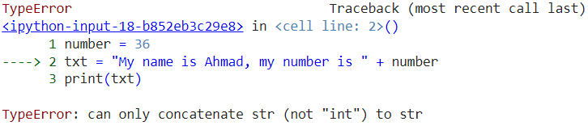
String concatenation
You can concatenate Strings using the + operator
it simply merges the String lists together
We cannot combine strings and numbers
How to make it works?
a = "Hello"
b = "Python"
c = a + b
print(c)
HelloWorld
number = 36
txt = "My name is Ahmad, my number is" + number
print(txt)

Slide 11
Formatting Strings
To make your string dynamic, you can add variables inside it and format using the format method
name = "Ahmad"
age = 33
salary = 500.95
result = "My name is {} and I am {} years old, My salary is {} dollars."
print(result.format(name, age, salary))
My name is Ahmad and I am 33 years old, My salary is 500.95 dollars.

Slide 12
Cont.
You can make order of the variables by using the index numbers
you can use the Literal String Interpolation f to add variables directly to the string
name = "Ahmad"
age = 33
salary = 500.95
result = "My name is {2} and I am {0} years old, My salary is {1} dollars."
print(result.format(name, age, salary))
My name is 500.95 and I am Ahmad years old, My salary is 33 dollars.
name = "Ahmad"
age = 33
salary = 500.95
result = f"My name is {name} and I am {age} years old, My salary is {salary} dollars."
print(result)

Slide 13
String methods
Python provides many built-in methods that makes you process (modify) Strings
Some of them are below
Method | Description
capitalize() | Converts the first character to upper case
format() | Formats specified values in a string
islower() | Returns True if all characters in the string are lower case
isnumeric() | Returns True if all characters in the string are numeric
istitle() | Returns True if the string follows the rules of a title
isupper() | Returns True if all characters in the string are upper case
lower() | Converts a string into lower case
lstrip() | Returns a left trim version of the string
replace() | Returns a string where a specified value is replaced with a specified value
rstrip() | Returns a right trim version of the string
split() | Splits the string at the specified separator, and returns a list
strip() | Returns a trimmed version of the string
title() | Converts the first character of each word to upper case
upper() | Converts a string into upper case

Slide 14
Escape characters
Python has some other characters that helps in modifying the format of the string
These characters are caller escape characters
Code | Result
\' | Single Quote
\\ | Backslash
\n | New Line
\t | Tab
\b | Backspace

Slide 15
Examples
result = 'My name is the name is \'Ahmad\''
print(result)
result = 'My name is the name is \nAhmad'
print(result)
result = 'My name is the name is \\Ahmad\\'
print(result)
My name is the name is 'Ahmad'
My name is the name is
Ahmad
My name is the name is \Ahmad\

Slide 16
Data type casting
In Python you can change from one data type to another
This can be done by passing the variable to the constructor of the desired type
Examples
From Integer (int):
To floating point: float(5) # 5.0
To string: str(5) # "5"
To complex: complex(5) # 5+0j
From Floating Point (float):
To integer (truncates the decimal): int(5.7) # 5
To string: str(5.7) # "5.7"
To complex: complex(5.7) # 5.7+0j
From String (str):
To integer: int("5") # 5
To floating point: float("5.7") # 5.7
To complex: complex("5+7j") # 5+7j (Given the string represents a valid complex number)
Note
Some conversions results in loss of data, be careful!

Slide 17
Python Operators

Slide 18
Operator types
Operators are used to perform operations on variables and values.
Python supports different operators
Arithmetic operators
Assignment operators
Comparison operators
Logical operators
Identity operators
Membership operators

Slide 19
Arithmetic operators
Operator | Name | Example
+ | Addition | x + y
- | Subtraction | x - y
* | Multiplication | x * y
/ | Division | x / y
% | Modulus | x % y
** | Exponentiation | x ** y
// | Floor division | x // y

Slide 20
Assignment operators
Operator | Example | Same As
= | x = 5 | x = 5
+= | x += 3 | x = x + 3
-= | x -= 3 | x = x - 3
*= | x *= 3 | x = x * 3
/= | x /= 3 | x = x / 3
%= | x %= 3 | x = x % 3
//= | x //= 3 | x = x // 3
**= | x **= 3 | x = x ** 3
&= | x &= 3 | x = x & 3
|= | x |= 3 | x = x | 3
^= | x ^= 3 | x = x ^ 3

Slide 21
Comparison operators
Operator | Name | Example
== | Equal | x == y
!= | Not equal | x != y
> | Greater than | x > y
< | Less than | x < y
>= | Greater than or equal to | x >= y
<= | Less than or equal to | x <= y

Slide 22
Logical operators
Operator | Description | Example
and | Returns True if both statements are true | x < 5 and x < 10
or | Returns True if one of the statements is true | x < 5 or x < 4
not | Reverse the result, returns False if the result is true | not(x < 5 and x < 10)

Slide 23
Identity operators
Operator | Description | Example
is | Returns True if both variables are the same object | x is y
is not | Returns True if both variables are not the same object | x is not y

Slide 24
Membership operators
perator | Description | Example
in | Returns True if a sequence with the specified value is present in the object | x in y
not in | Returns True if a sequence with the specified value is not present in the object | x not in y

Slide 25
Logical vs bitwise and/or operators
For evaluating logical expressions, you should use and instead of &, or instead of |
Both & and | are bitwise operations, which evaluate both sides of the expression
For example,
and/or evaluates the first part of the expression, some times do not need to evaluate the other
For example, for (F AND T), the AND operator does not need to evaluate the second part, T, as anything AND F is F, but (T and F), the operator needs to check the second part
opposite with OR
4 & 5 => 0100 & 0101 => 0100
print (4 & 5)
output: 4
4 | 5 => 0100 & 0101 => 0101
print (4 | 5)
output: 5

Slide 26
Operator Precedence
Operator | Description
() | Parentheses
** | Exponentiation
+x -x ~x | Unary plus, unary minus, and bitwise NOT
* / // % | Multiplication, division, floor division, and modulus
+ - | Addition and subtraction
& | Bitwise AND
^ | Bitwise XOR
| | Bitwise OR
== != > >= < <= is is not in not in | Comparisons, identity, and membership operators
not | Logical NOT
and | AND
or | OR
When two operations have the same precedence, we evaluate the expression from left to right:

Slide 27
Examples
x = 5 # 0101 in binary
y = 3 # 0011 in binary
result = not x & y or x ^ y and x - 1 | y + 1
x = 10
y = 3
result = x * y + x / y - x ** y % 5
Operator | Description
() | Parentheses
** | Exponentiation
+x -x ~x | Unary plus, unary minus, and bitwise NOT
* / // % | Multiplication, division, floor division, and modulus
+ - | Addition and subtraction
& | Bitwise AND
^ | Bitwise XOR
| | Bitwise OR
== != > >= < <= is is not in not in | Comparisons, identity, and membership operators
not | Logical NOT
and | AND
or | OR
a = 4
b = 6
c = 8
d = 10
result = a < b and c > d or not c - d * b + a == -52
Show me a step-by-step evaluation of the above expressions (homework)

Slide 28
a = 3
b = 2
c = 10
d = 15
e = 4
f = 16
result = (a + b * b < c) or (d / c == c / d and e ** 2 > f)
Operator | Description
() | Parentheses
** | Exponentiation
+x -x ~x | Unary plus, unary minus, and bitwise NOT
* / // % | Multiplication, division, floor division, and modulus
+ - | Addition and subtraction
& | Bitwise AND
^ | Bitwise XOR
| | Bitwise OR
== != > >= < <= is is not in not in | Comparisons, identity, and membership operators
not | Logical NOT
and | AND
or | OR
x = 5 # 0101 in binary
y = 3 # 0011 in binary
# 4 0100
# 2 0010
result = not x & y or x ^ y and x - 1 | y + 1

